Slide 1
Entertainer Data Analytics

Slide 2
agenda
Introduction
Problem Statement
Main KPIs
Insights
Dashboard
Summary

Slide 3
Introduction
In today's fast-paced world, entertainment provides a necessary respite from the stresses of daily life. This vast sector not only engages audiences but also drives significant economic activity. By examining key data trends, we can uncover insights into content performance, and emerging patterns, helping stakeholders make informed decisions. This project leverages data science tools to explore and analyze data from various entertainment sources, enhancing our understanding of industry dynamics.

Slide 4
Problem Statement
As modern life grows more stressful, people increasingly seek ways to unwind and escape. The entertainment industry, spanning movies, TV shows, radio, and print media, fulfills this need by delivering diverse content that helps people de-stress and face life's challenges with renewed energy. Given the vast data generated in this industry, analyzing it effectively can reveal insights into content success, and trends. This project aims to dissect these data patterns to provide actionable insights, using data science to explore key aspects of the film and entertainment sector.

Slide 5
Main Kpis
Year of first major award : Year in which entertainer won their first major award.
Year of Breakthrough : Year of their first breakthrough/ Hit/ Award Nomination.
Year of Last major work : Year in which they did their major work.

Slide 6
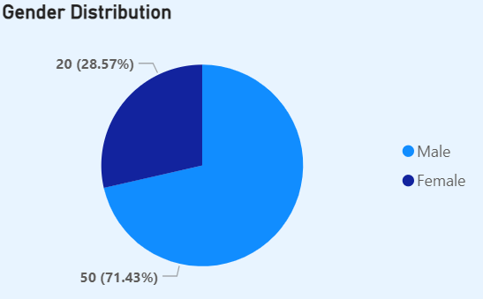
Insights - Gender Distribution
This shows the distribution of Entertainers based on their gender.
In this data, Males (71.43%) exceeding the Females (28.57%).

Slide 7
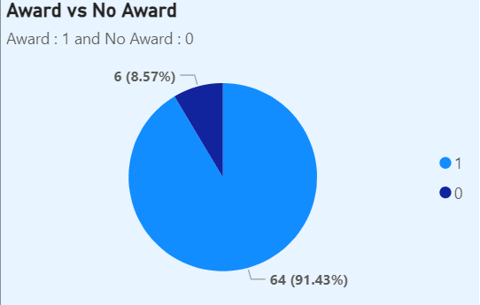
Insights – Award winners
This chart shows the comparison between Entertainers who have won any major awards or not in their career.
We can clearly see that there are 91.43% actors who have won awards in their career.

Slide 8
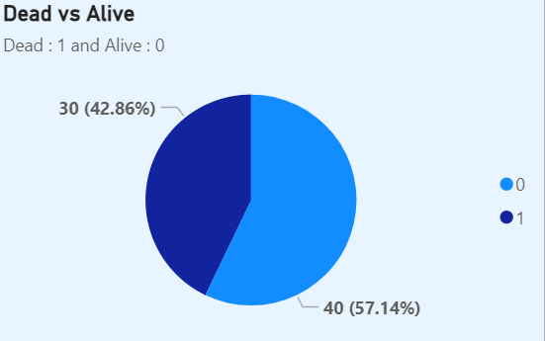
Insights – Dead and Alive Count
This is the count of actors who are dead and alive.
In the given dataset, 42.86% entertainers are dead while 57.14% entertainers are still alive.

Slide 9
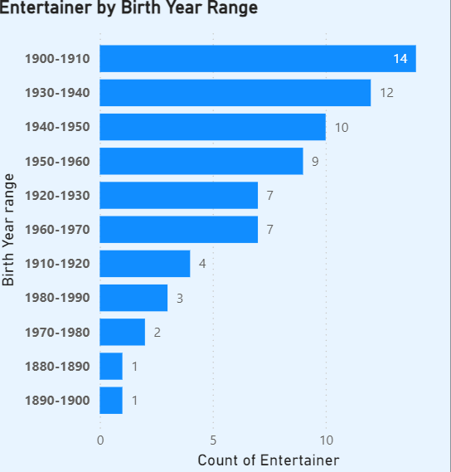
Insights – Entertainer by birth year range
This presents the number of entertainers in a particular birth year range divided in decades.
Where the highest number of entertainers (14) were born in the year range of 1900-1910.

Slide 10
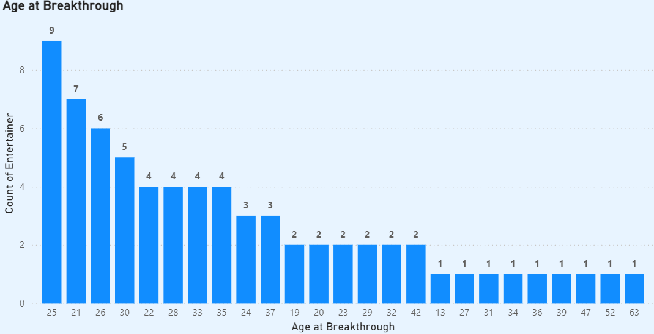
Insights – Age at breakthrough
The highest number of Entertainers (i.e. 9) having age at breakthrough year is 25.
This is the only age group that showed highest number of entertainers.

Slide 11
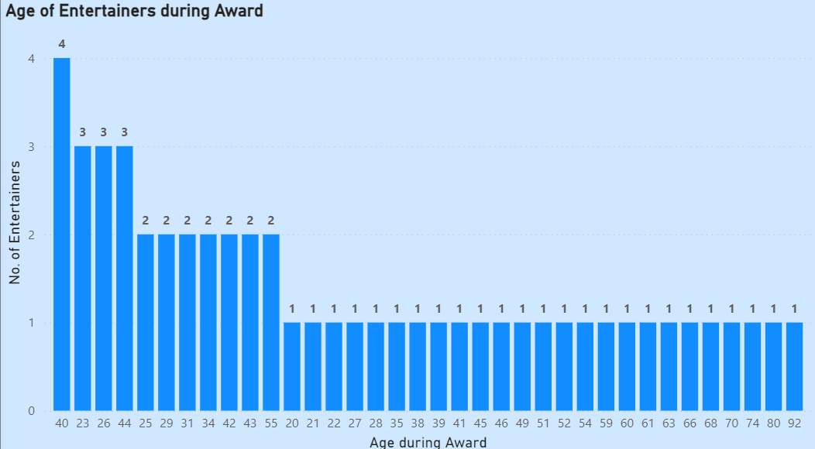
Insights – no. of actors during major award year
This shows the age of number of Entertainers when they won their major award in their career.
Where 40 is the age group that showed the highest number of entertainers (i.e. 4) that won the major award at that age.

Slide 12
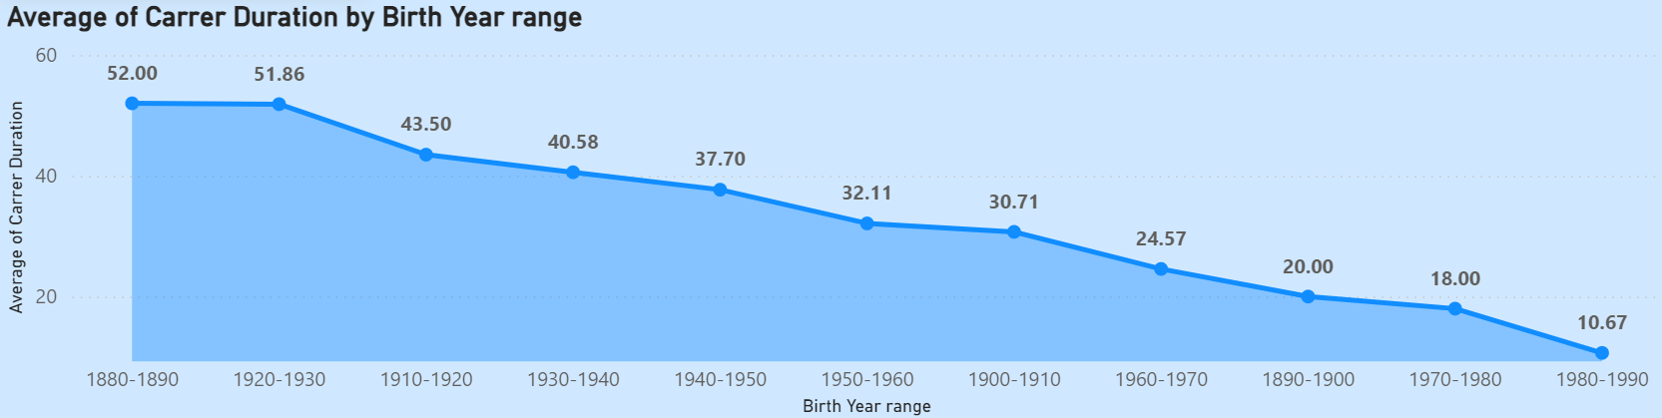
Insights – Avg of career by birth year range
This is the average of career duration of actors in their particular birth year range where the range 1880-1890 showed the highest average of career which is 52.

Slide 13
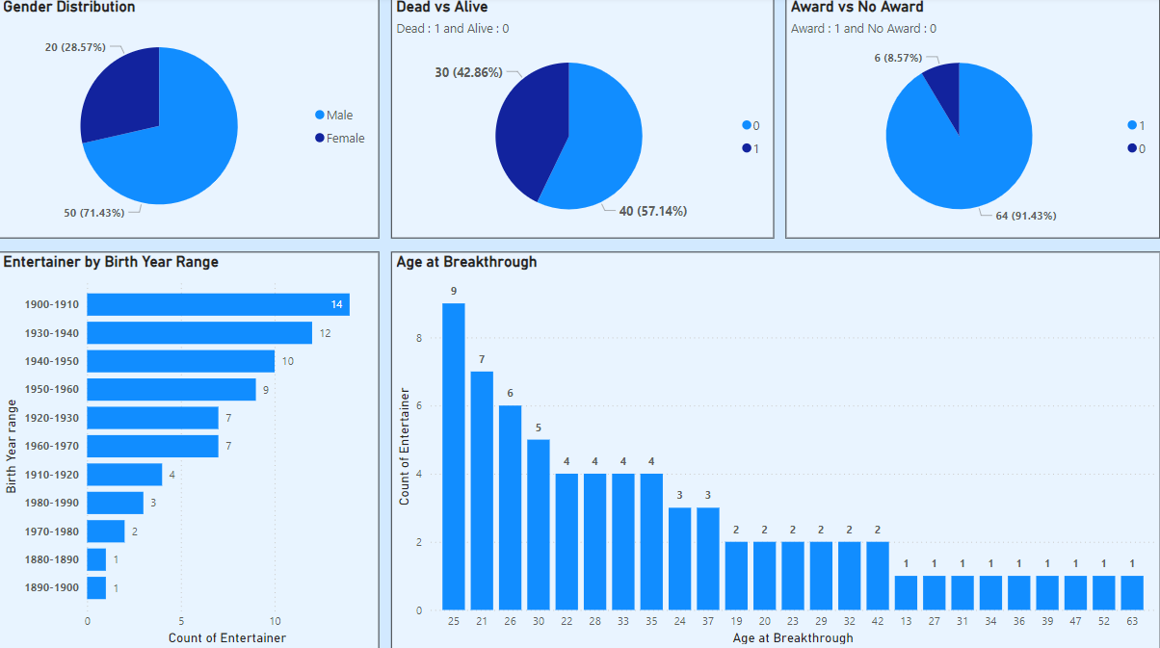
Dashboard 1

Slide 14
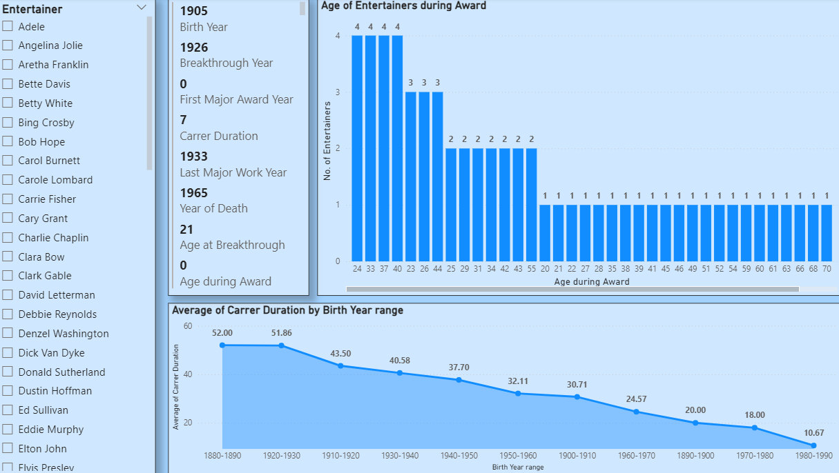
Dashboard 2
In dashboard 2, we have a slicer and multi row card which shows the details of particular Entertainer in a card.

Slide 15
summary
Males dominated the industry with 71.43%.
Award winners were 91.43%.
Dead count is 42.86%.
Highest number of entertainers which is 14 were born in 1900-1910.
Highest number of Entertainers which is 9 having age at breakthrough year is 25.
4 is the highest number of actors that won major award at the age of 40.
1880-1890 is the birth year range in which actors had the highest avg career duration which is 52.

Slide 16
Thank you
Gaurav Rawat
gauravrawat4657@gmail.com

